Slide 1
Week 4: Variational Models

Slide 2
Limitations of AR Models
Last week: autoregressive models
They work well for not very long sequences e.g., text
Major limitations:
O(n): Inference runtime linear in sequence length
Require some ordering
Cannot take advantage of low rank (next slide)

Slide 3
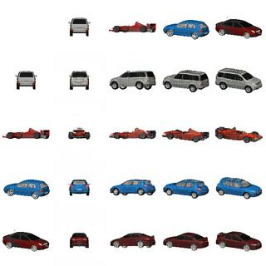
Illustration - Low-Rank Data
Let’s look at Cars3D
Synthetic and very simple
Every image specified by only three factors:
Model – [1…M]
Azimuth – [0-360]
Elevation – [-90,90]

Slide 4
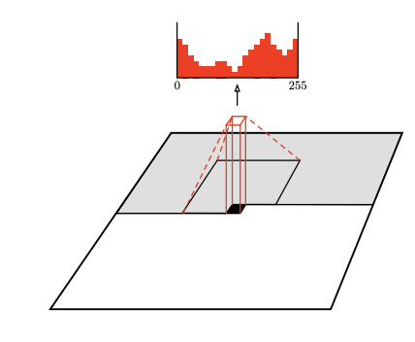
AR Models for Cars3D
Decide on some ordering of the pixels
Train a model to predict p(x_{n+1}|x₁,x₂,…,x_{n})
Not the best fit:
No natural orderin
There are 64X64X3 pixels, so requires as many NN evaluations
Approach too complex for such a simple dataset
Still, many well cited papers do this with massive neural nets:
PixelCNN/PixelRNN (Google), ImageGPT (OpenAI)

Slide 5
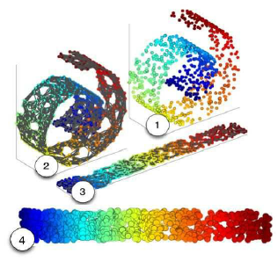
Low-Rank Manifold Assumption
Generally, the data we observe in the world is of high dimension
Often generated by a small number of factors of variation
When the factors are unknown, they are called hidden or latent

Slide 6
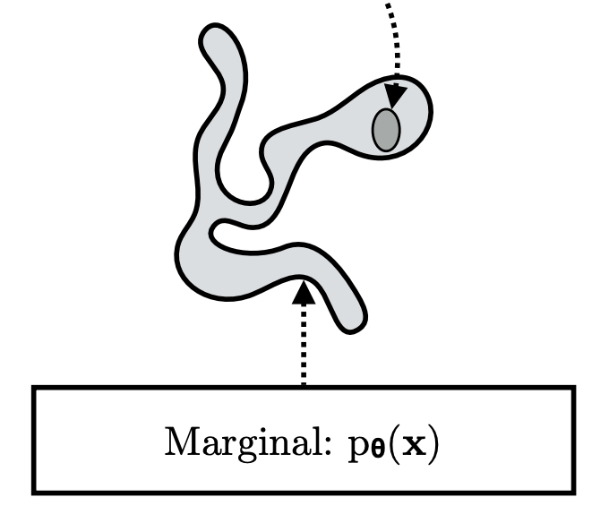
Generative Model Objective
Assume we have a set of training data (e.g. images) x₁.x₂..x_{N}
We want to learn a function p(x) that:
The train/test images have a high likelihood (p(x))
Easy to sample from it
Can use it to compute point estimates
Same as last week

Slide 7
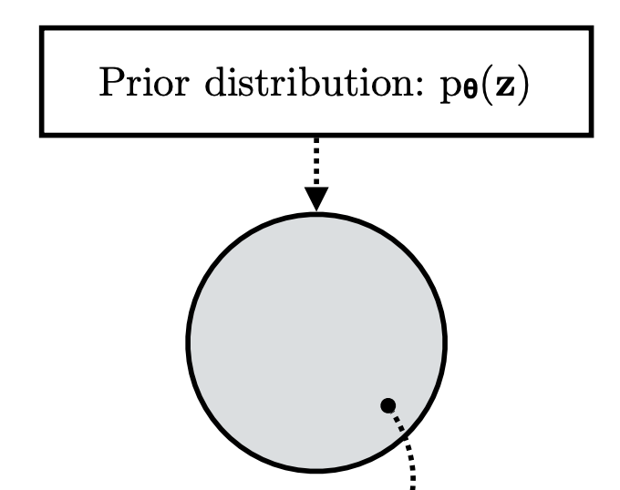
Latent Variable Representation
A simple model for this data
Data represented by a hidden (latent) variable z of (typically) low-dimension
Latent variable has a simple distribution p(z)
E.g. Uniform, Gaussian, Multinomial
Code p(z) is a compact representation of p(x)

Slide 8

Example: Car3D Prior
In Cars3D we can choose a prior term over three hidden factors
The model may choose to represent: z₁=type, z₂=pose, z₃=azimuth
The z factors can be a complex combination of the factors though
We may choose a uniform distribution over each factor

Slide 9
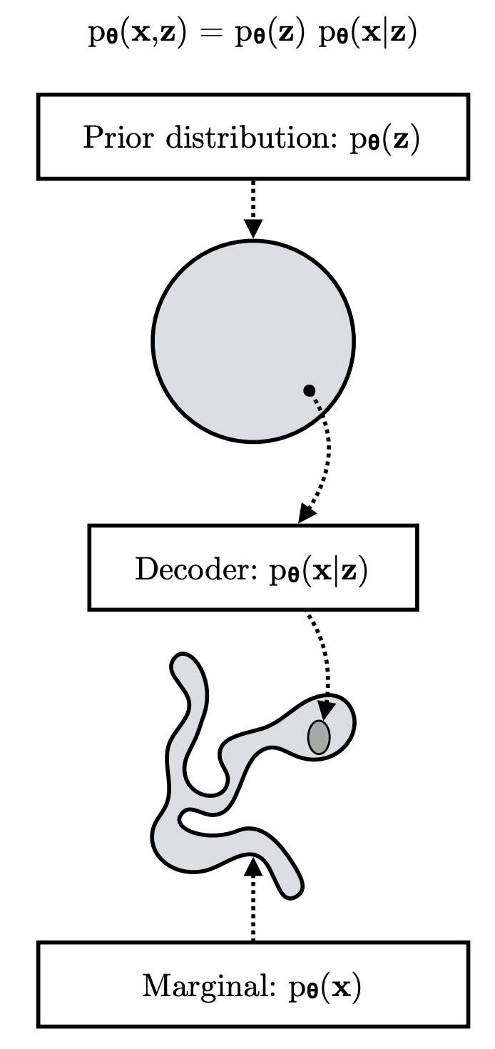

Generator
A latent variable z is mapped into a distribution over images x using function G
Intuitively, G(z) is the most likely image given latent code z
The images are typically of much higher dimension than z
The function can be complex e.g. transformer

Slide 10

Posterior
Our objective is to have a probabilistic model
We model the probability of image x given code z
Here we use a simple Gaussian PDF

Slide 11


Likelihood
The distribution of x under of model
A function of the prior and posterior

Slide 12

Two Challenges
Efficiently compute the value of provided x
Find the optimal parameters such the data is most likely under the model (max-likelihood)

Slide 13


Preliminary: Importance Sampling
Assume that you wanted to estimate the following:
When f is a function and p is a PDF
This can also be written:

Slide 14

Monte Carlo Estimation
Computing the integral might be hard
Instead, we can perform a sampling-based approach
Sample N values from p(x): x1,x2..xN
Estimate the average value of f on samples from p

Slide 15
Simple Estimation May not Work
Several problems can occur:
We may not know how to sample from p
Sampling from p may require too many samples - see whiteboard

Slide 16
Proposal Distribution
Propose another probability distribution Q(x) such that:
It is easy to sample from
High probability at high values of p(x)f(x)
Can we estimate expectation with respect of Q instead of P?
No! this estimator is biased

Slide 17

Unbiased estimator
Estimation with respect to Q requires importance weighting
Where
It will have low-variance when
I.e. require fewer samples for a good estimate

Slide 18


Back to Inference
We want to estimate p(x), we know both p(x|z) and p(z)
This is a simple expectation
However
Nearly all z we sample will yield 0 p(x|z), too many samples needed

Slide 19


Idea: Importance Sampling for Inference
Let us propose distribution q(z), and compute expectations
In practice, we case about log(p), so using Jensen’s inequality:

Slide 20
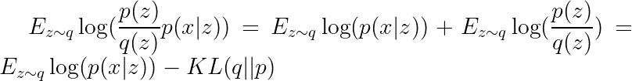
Simplifying the Expression
The expression simplifies to:
The term is called the Evidence Lower BOund (ELBO)
First term is the expectation of p(x|z) with respect to q (instead of p)
The second term penalizes large difference between p and q

Slide 21
What is the Best Prosposal Distribution
How to select the best proposall distribution Q for image x?
Idea: optimize it!
It follows that:
In fact , if we are free to select any q, equality follows

Slide 22
What is the Theoretically Optimal Q?
Let us substitute q(z) = p(z|x) - also called the posterior
There is therefore no proposal better than the posterior
However, it is typically infeasible to compute
Direct optimization of q(z) is therefore the practical path

Slide 23

Variational Approximation in Practice
In practice, we want q(z) we be easy to sample from
Let us choose a Gaussian
Independent dimension
Each dimension d has
Optimization = finding the optimal set of. for all d

Slide 24
Estimation of Likelihood of Entire Dataset
We may want to estimate likelihood of multiple images x₁..x_{N}
For each image x_{i}, we find optimal proposal distribution q_{i}
Estimate log likelihood via:
Log-likelihood of entire dataset becomes:

Slide 25
Wait, But Where did P(x|z) Come From?
In the previous discussion, we assume we know P(x|z)
In fact, we need to learn p(x|z)
Remember that:
So this means we need to learn the generator function G

Slide 26
Maximum-Likelihood (ML) Estimation of G
We seek generator G under which the observed data is most likely
We therefore jointly optimize the parameters of G and of q₁..q_{N}
Where optimizing over qi is optimizing over the mean and covariance

Slide 27
Re-Parameterization Trick
Optimizing over sounds poorly defined
This is because the RV z depends on the optimization parameters
We solve this by rewriting
Expectation is over random samples from the normal distribution
Optimization is over the deterministic parameters

Slide 28
Latent Optimization
The formalism requires optimization of mean, var for every sample x_{i}
Cumbersome for large training sets
Might cause overfitting

Slide 29
Amortized Inference
Breakthrough work of Kingma and Welling
Proposed to replace the per-sample q_{i} by a learned encoder
The formalism is called the variational autoencoder (VAE)

Slide 30
VAE Optimization in Practice
To simply the maths, we often:
Choose p(z) = N(0,I)
Estimate the expectation using a single normal sample
The optimization becomes:
Where the KL can be evaluated precisely:

Slide 31
Recap: Amortized Variational Inference
To find the best generator G, we need to estimate data likelihood
Simply taking expectation over z is too inefficient
Learn the best proposal distribution q for each x
Jointly optimize of G and q for all training set
Instead of optimizing q for each x, train an encoder

Slide 32
Code
Latent optimization (GLO): https://github.com/yedidh/glann/blob/master/glo.py
Amortized inference (VAE):
https://github.com/AntixK/PyTorch-VAE/blob/master/models/vanilla_vae.py

Slide 33
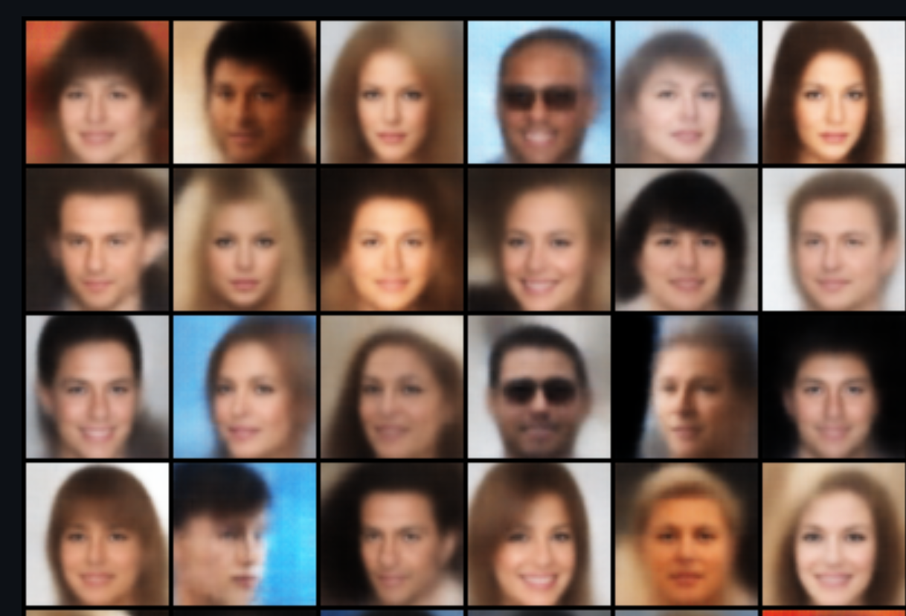
VAE Samples
While VAE is theoretically sound, the results are blurry

Slide 34

Using VAE for Point Estimation
VAE can be use for computing p(x)
We do not have to make the variational approximation
About 100 samples of z are recommended for good accuracy

Slide 35
Conditional VAE
Let’s get more practice with variational inference
Assume that every sample x is also conditional on c

Slide 36


A Few Manipulations
Choosing proposal q(x|c,z):
With the variational approximation, the conditional ELBO is:

Slide 37
cVAE Loss
Simplifying, this is the cVAE loss:
It is also possible to do this with latent optimization (LORD, week 10 )

Slide 38
Summary
Some datasets are well described by low-rank latent variables
Variational inference allows likelihood calculation
Can be used for training better generators of the data
VAE proposed to amortize the proposal distributions
Conditional inference has a very similar form

